Slide 1
BTEC Media
Revision
HOOK
Log on to the PCs and follow this path:
Shared → BTEC Media → Independent Study Resources → Unit 1 Revision → Past Papers→ ‘2019 Examiner Report’

Slide 2
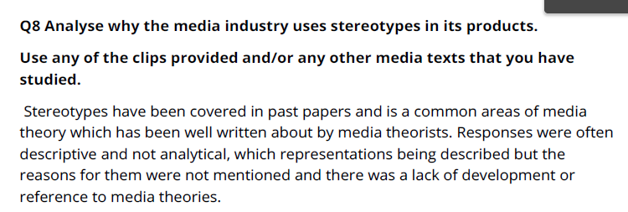
BTEC Media
Revision
Hook
Line
How do I answer a question on stereotypes?
Which examples did you use?
Analyse the clips you have been given if easier.
Their examples:
Rodger Rabbit
Lara Croft
Disney Princesses
Children in horror films
Notes:
https://www.youtube.com/watch?v=yy5THitqPBw

Slide 3
BTEC Media
Revision
Hook
Line
How do I answer a question on stereotypes ?
You have 15 minutes to answer this question- in your exam you will need to 10 minutes.
In your answer discuss stereotypes- why they have been done (does it link to a genre and is common? Where has it come from? How does it appeal to its audience?)
Examples you could use:
Black representation/ low class- Top Boy
Masculinity- Captain America/Iron Man/Batman/Superman
Women as sexual objects- Blurred Lines/ Transformers/ Lara Croft
Women as weak- horror films and often killed first/victims
Theories:
Dyer
Hall (encode/decode)
Reception Theory

Slide 4
BTEC Media
Revision
Line
Multiple readings= polysemy/ polysemic readings
Could be interpreted differently due to:
- Culture/Beliefs
Age
Gender
Ethnicity
Class
Stuart Hall Reception Theory:
Dominant/Preferred Reading- the reading the producer wanted the audience to gain. E.g. scared if it’s a horror film
Negotiated Reading- partly achieve the preferred reading.
Oppositional Reading- Disagree with the preferred reading.
Aberrant Reading- Did not understand what the preferred reading is.
All fits with encoding (what the producer does) and decoding (how we interpret it).

Slide 5
BTEC Media
Revision
Line
Examples:
GTA V
Breaking Bad
Others:
POWER
Transformers
Mean Girls
White Chicks
COD

Slide 6
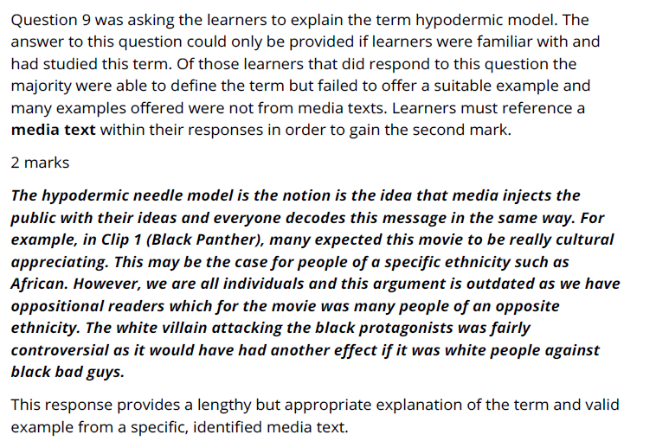
BTEC Media
Revision
Line
Which examples would you use?
How would you explain it?

Slide 7
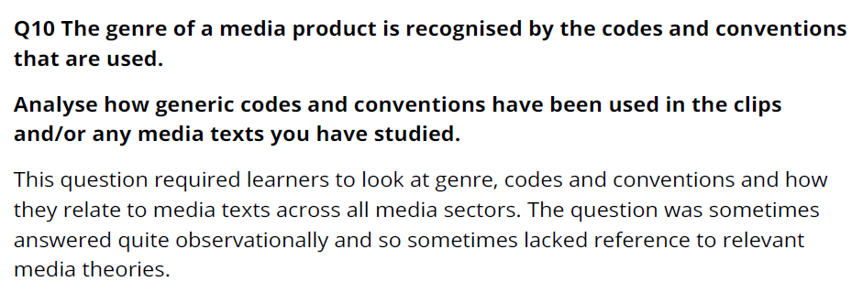
BTEC Media
Revision
Line

Slide 8
BTEC Media
Revision
Line
What do you associate with a superhero action film?
Remember superhero is a sub-genre (a genre within a genre)
HOW are the following clearly superhero films?
https://www.youtube.com/watch?v=6ZfuNTqbHE8 – Avengers Infinity War
https://www.youtube.com/watch?v=n9DwoQ7HWvI – Spiderman Home Coming

Slide 9
BTEC Media
Revision
Line
What do you associate with a horror film?
HOW are the following clearly horror films?
https://www.youtube.com/watch?v=hAUTdjf9rko – IT
https://www.youtube.com/watch?v=paFgQNPGlsg – Anabelle

Slide 10
BTEC Media
Revision
Line
What do you associate with animated films ?
Remember animated films are sub genres of action.
https://www.youtube.com/watch?v=AokzSB6BwMs – Ralph (how far is it clearly an action film?)

Slide 11
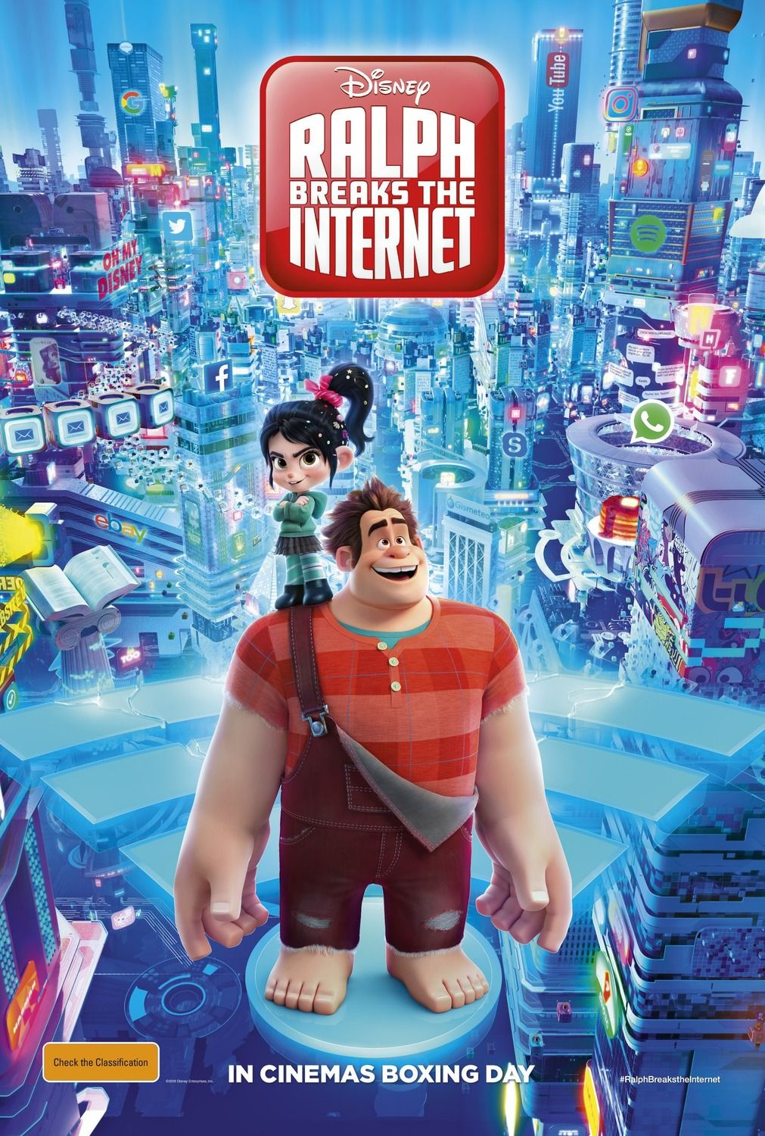
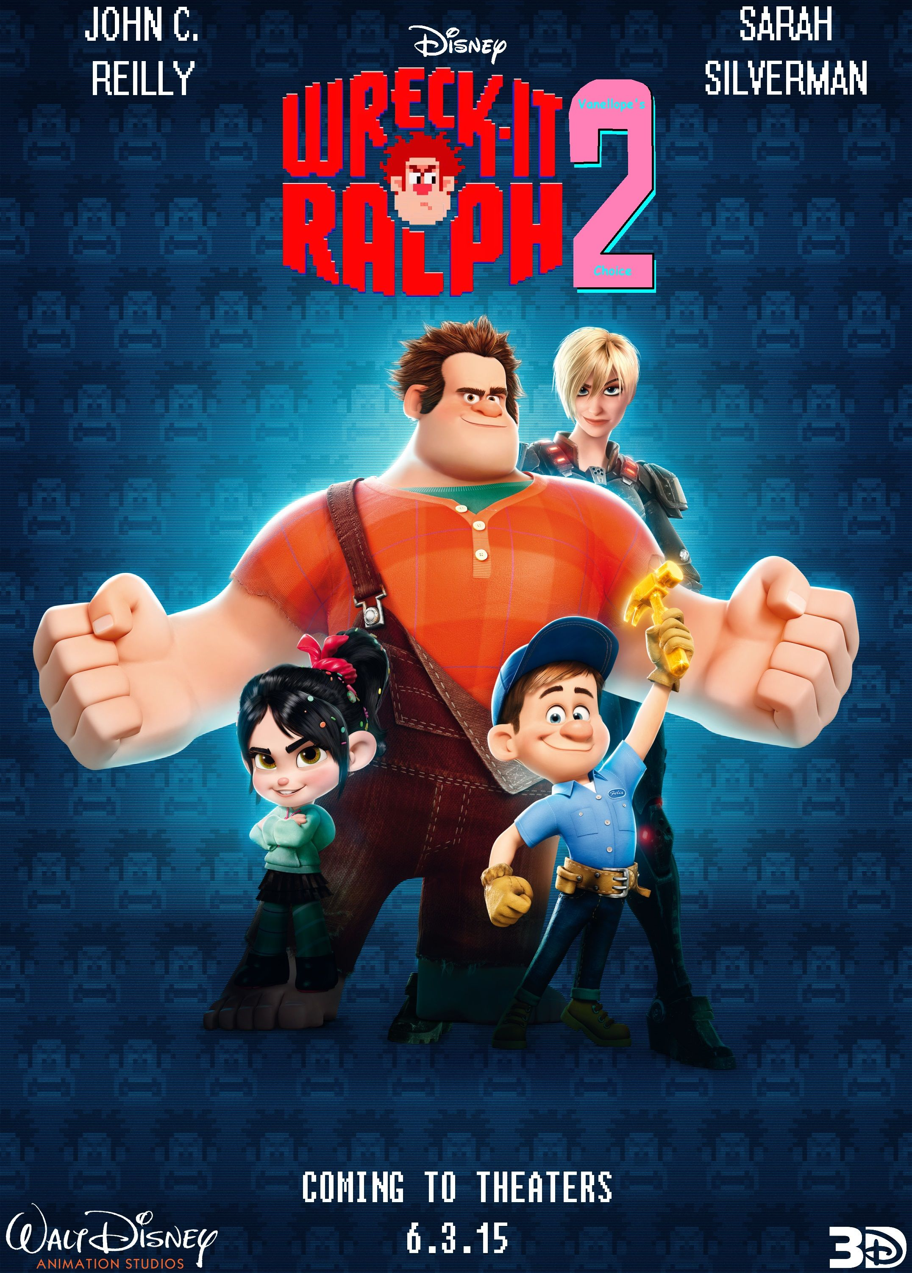
BTEC Media
Revision
Line
Analyse how genre codes have been applied to the poster to appeal to a family audience (10)

Slide 12
BTEC Media
Revision
Most recent films goes against conventions of genre to them from getting repetitive.
Analyse how the media uses subversion of genre through codes and against conventions (10)
Hard Out Here- goes against pop genre conventions
against horror conventions
https://www.youtube.com/watch?v=E0CazRHB0so
Hush- using disability to go against horror conventions- usually women are represented sexually or weak. Here a deaf woman is the hero and survives against the dominant man
https://www.youtube.com/watch?v=Q_P8WCbhC6s
- Don’t Breathe- goes against horror conventions
Old man, disability is the main villain, villain wasn’t looking for trouble, alpha male dies first, female strong lead.
https://www.youtube.com/watch?v=76yBTNDB6vU
US – goes against horror conventions using psychological themes
https://www.youtube.com/watch?v=hNCmb-4oXJA
Bird Box- goes against thriller conventions- blind folds unusual for thrillers- narrative revolves around the light having a bad spirit which leads you to commit suicide.

Slide 13
BTEC Media
Revision
Most recent films goes against conventions of genre to them from getting repetitive.
Analyse how the media uses subversion of genre through codes and against conventions (10)
A horror film conventions are the use of iconography (something iconic to a genre) through the use of props such as knives, makeup of blood and low key lighting set in a isolated place with intense use of sound to create an atmosphere for the audience. Usually the victim is a sexualised woman that is in need of help and is killed first in the film (if there is a group). Horror films usually end on a resolution that isn’t fully resolved to scare the audience as they feel it could happen to them.
The film Hush however has some of these conventions but also massively goes against them. There is female lead however she not stereotypical as she has a disability (she is deaf and cannot speak). Arguably this makes the film more scary as she’s unaware and is extra vulnerable (a stereotype with disability). Although at the end of the film, she defeats him with a cross-bow and is the hero (Propp’s theory). This goes against conventions of a horror film. Nonetheless it is conventional as it uses non- diegetic sound of deep tones and diegetic sound to create realism to scare the audience which builds tension.
Mega mind is a subversion to the sub-genre of action- superhero films. This is due to the main character being an anti-hero/antagonist. The producers have encoded that he is a villain the codes of the black leather costume which could connote to death and evil.
However due to the amount of screen time (editing) we like his character. This goes against conventions of superhero films as usually they focus on the hero, not the villain. Although at the end it is made clear he is a hero as it shows that change is positive and that people that are bad are not fully naturally bad which influences children to consider their actions to others, which is an effect mentioned by Stuart Hall (Education) and the gratification of Information (Uses & Gratifications).

Slide 14
Propp’s theory
Hero
Villain
Princess/ Damsel
Helper
Donor (someone that gives the hero something to help)
Dispatcher- sends the hero on the quest
False Hero

Slide 15
BTEC Media
Revision
What examples would you use that show masculinity?

